Slide 1
Telco Customer Churn
Nakos Alexandros

Slide 2
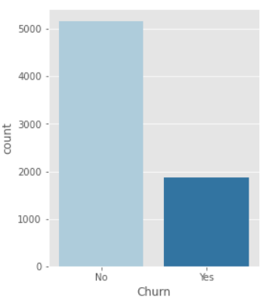
Initial steps – Churn Distribution
Loading the data
Check whether there are any Na values
Eleven na values in monthly charges
They also have zero tenure
We decide to drop them
Checking Target Attribute
5174 Non-churn customers
1869 churned Customers
Unbalanced dataset
Non-churn customers favored

Slide 3
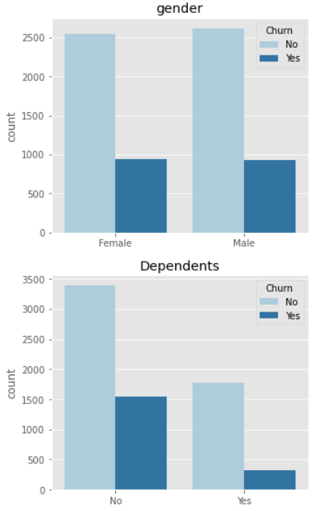
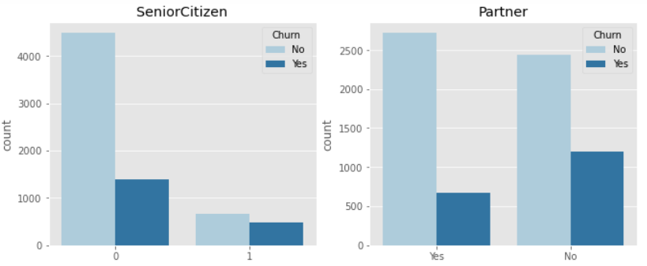
Categorical Attributes - demographics
Churn seems to be the same for both Genders
The number of customers categorized as Seniors is low
Churn is higher for those who have no partner and no dependents

Slide 4
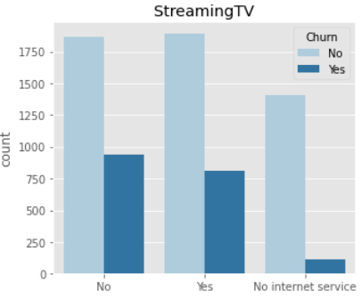
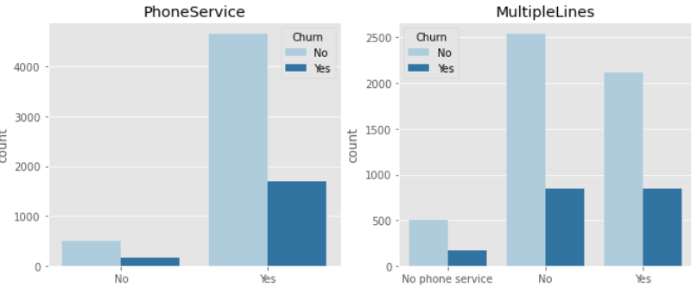
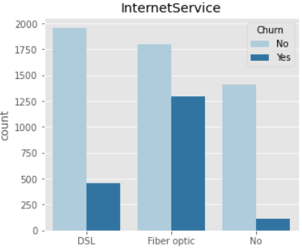
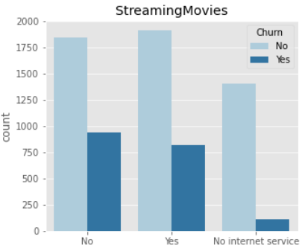
Categorical Attributes - Services
Streaming TV and Movies have almost identical distributions
Fiber Optic is the Internet Service of choice, also with a high count of Churn
Churn for multiple lines Is the same
Customers with phone service show high churn

Slide 5
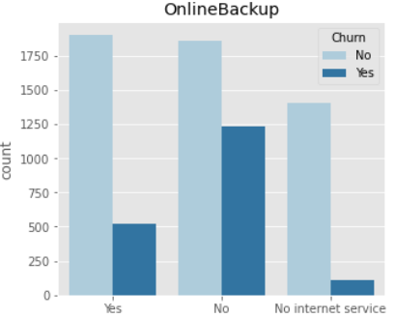
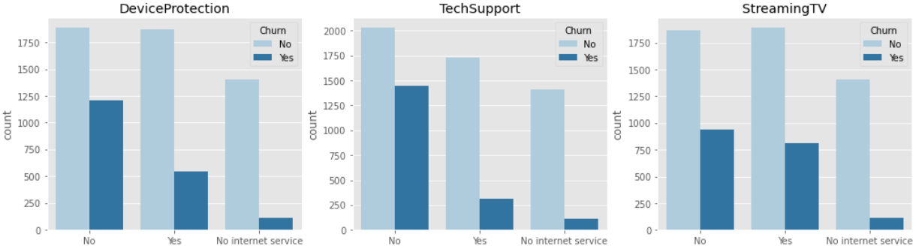
Categorical Attributes - Support
All attributes shown are important with regards to churn
When they are not present customer churn is significantly higher

Slide 6
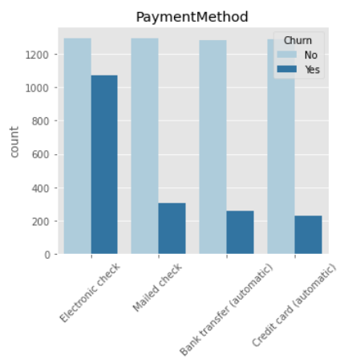
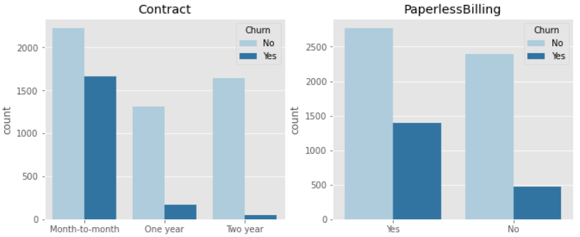
Categorical Attributes – Payment/contract
Churn is high for customers with month-to-month contract
Same for customers with paperless billing enabled
Almost all customers with electronic check as payment method churned

Slide 7
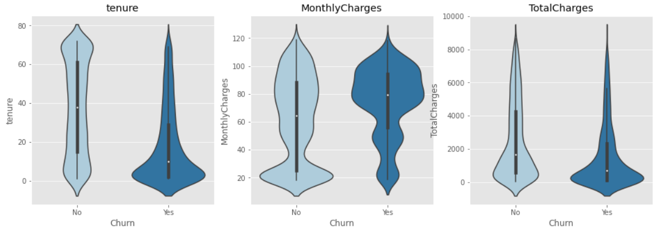
Numerical attributes
Customers who decide to leave, do so in the first months
Customers that stay display a uniform distribution regarding their tenure
Churn is higher among customers with high monthly charges

Slide 8
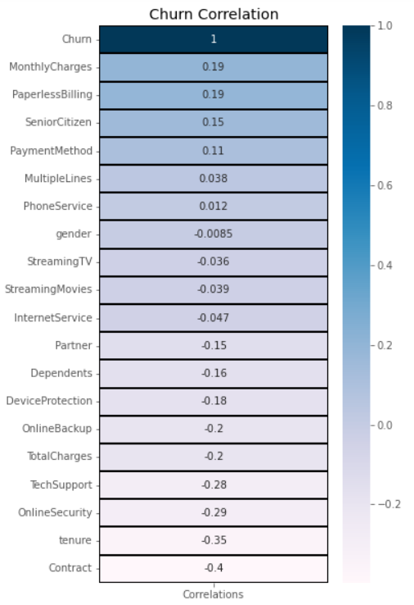
Feature selection
Correlation plot w.r.t churn
Drop attributes with low correlation
Multiple lines
Phone service
Gender
Streaming TV
Streaming movies
Internet Service
One hot encoding categorical attributes
Standardization of numerical attributes

Slide 9
Classification models
 | DECISION TREE | BAGGING CLF (DT BASE) | RANDOM FOREST | ADAPTIVE BOOSTING | GRADIENT BOOSTING
ACCURACY | 72.80% | 77.55% | 77.79% | 79.63% | 79.59%
ROC AUC | 72.80% | 85.59% | 86.78% | 87.95% | 88.49%
F1 | 73.51% | 76.64% | 77.49% | 79.74% | 79.49%
RECALL | 75.51% | 73.64% | 76.52% | 80.20% | 79.06%
Adaptive and Gradient boosting shows the most promising results
Proceed to Further optimization

Slide 10
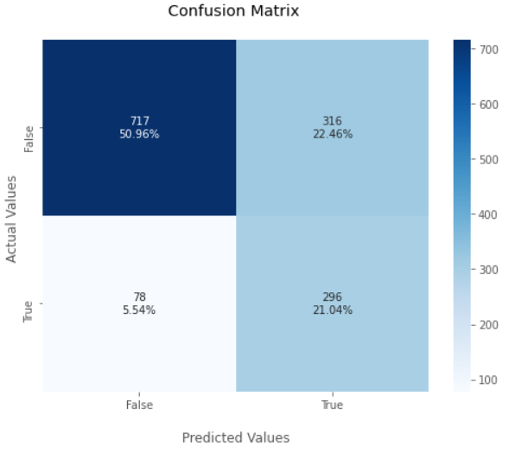
Gradient Boosting
Imbalanced dataset
F1 score as optimization measure
5 k-fold cross validation
ACCURACY | 71.99%
ROC AUC | 74.27%
F1 | 60.04%
RECALL | 79.14%

Slide 11
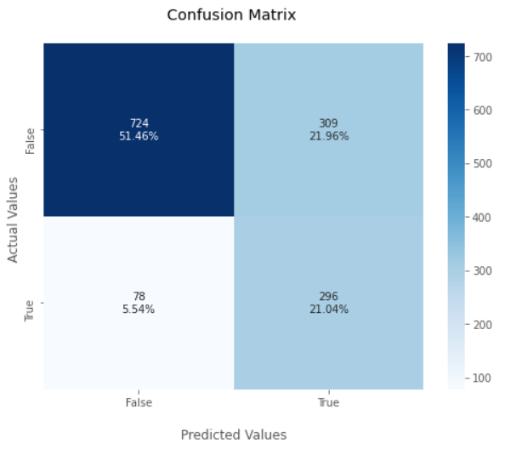
adaptive Boosting
Imbalanced dataset
F1 score as optimization measure
5 k-fold cross validation
ACCURACY | 72.49%
ROC AUC | 74.61%
F1 | 60.46%
RECALL | 79.14%

